Slide 1

Web-Forum
Author: Artem Stryzhakov

Slide 2
Planning:
Definition of goals and objectives of the project;
Development of the site structure;
Development of design layouts;
Html layout;
Programming and quality control;
Launch and maintenance, SEO-optimization.

Slide 3

Requirements:
Possibility of registration, authorization and exit.
Ability to create posts , edit posts, and delete them.
Be able to comment on other users' posts.
Minimum 5000 users can discuss one topic.

Slide 4
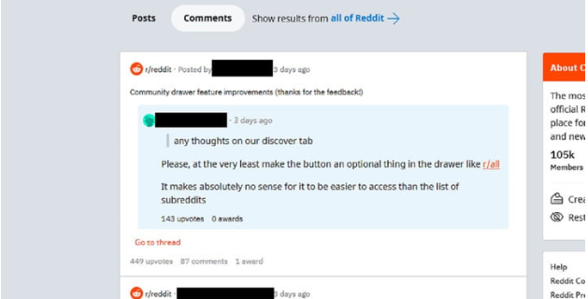
Design:
Determine the basis of the design
After coding is finished, the main part of the design begins, as it is much easier than designing for something that does not exist yet.
modern design, not inferior to other Internet forums

Slide 5

Coding:
Coding the site structure (what will be responsible for what)
Create and connect to the site a database that will store all the necessary and important data
Coding the ability to log in and log out
Coding the system of the forum itself, namely how it will work

Slide 6

Testing:
After finishing coding and thinking over the design for our forum, it is necessary to test our forum, if errors occur somewhere or something does not meet the requirements during testing, then we change what is necessary. At the same time, we have a relationship with the client, if the client does not like some idea, then we change it at his request.

Slide 7

Maintance:
The end of the project is that this product is sent to the customer, in return we receive payment for the work. The web forum is also being maintained, the system is being improved over time and new forum features are being added.

Slide 8

Thank you for attention!

